Slide 1
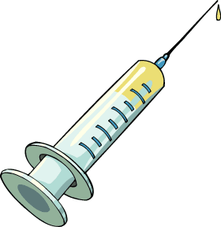
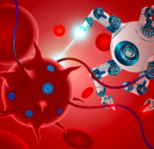
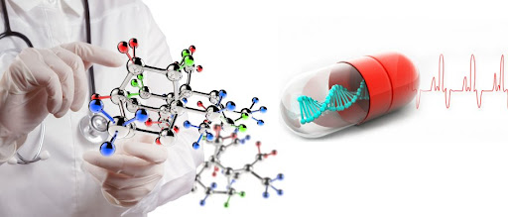
What they are putting in is from the pit of hell
Dr Alphonzo V Monzo III, ND, LPNM, MH, LMT, MDiv

Slide 2
Biophysics – How the Energetic Body works
Everything is energy, frequency, and vibration!
Everything in the body has a frequency or Energetic Signature.
The Bio-electric systems work via communication.
The Bio-electric systems circulate and function as resonators of frequency (Force/ Movement & information) which manifest into a physical body.
The unseen creates the seen!! (Shadow DNA!)
These subtle energy systems do not like to be forced stimulated!!! - Proper resonation & Circulation is the goal.

Slide 3
PROPER COMMUNICATION IN PHYSICS & BIOPHYSICS
In-Phase Coherence = proper communication = Message received and understood
Out of phase Incoherence = improper communication = Message not completely
received and/or misunderstood

Slide 4
HOW THE BODY REALLY WORKS! THE CORRECTED LEVELS OF STRUCTURAL ORGANIZATION
7) Organismal Level – Everything comes together to form you

Slide 5
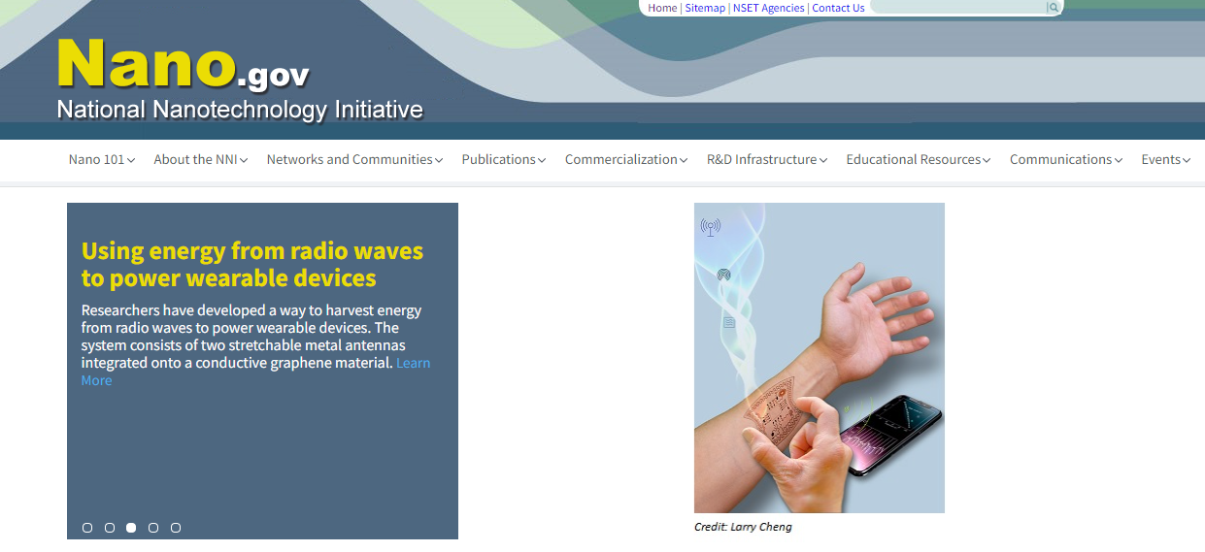
Nanotechnology
Nanotech – It’s everywhere now!
One particle can hold 1TB of data
Some have built-in AI
Nanotech can modulate 100K per second
Size – A nanometer is one billionth of a meter. A sheet of paper is about 100,000 nanometers thick.

Slide 6
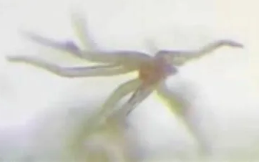
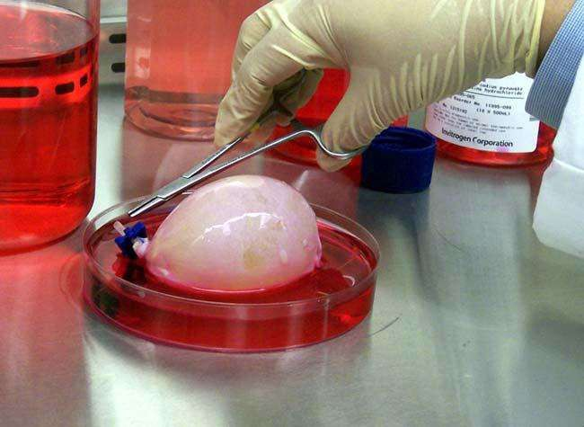
Nanotechnology
Nanotechnology Types:
Nanotech Software (SIT)
Nanotech Particles/Materials
Nanotech Machines
Nanotech Pathogens (WPNP)
Nanotech Lifeforms or Biology

Slide 7
What are Weaponized Pathogens?
Weaponized Pathogens – man-made, genetically engineered and combined with other pathogens, toxins, and technology to cause physical, mental, and emotional harm and control behavior.
WPNPs – the goal seems to be to make people miserable and act as subtle behavior modification organisms.
WPNPs – More like mingled seed, which goes against everything our Creator has instructed!!
WPNPs and SIT (Nanotech) – Sci-Fi no longer fiction! Satanic futuristic goals foretold.

Slide 8
Three Main Things that Make up WPNPs:
Mixed Seed – the mingling of multiple organisms or pathogens into one host pathogen
Chemical and Heavy metal usage and/or toxins
Nanotech – SIT, including AI systems, smart dust, nanowires, xenobots, etc.
Some WPNPs have up to six or nine categories of martials such as: Pathogens, Metals, Venom, Virus (software), Nanotech, spirit(s), Gene tech, Quantum tech, etc.

Slide 9
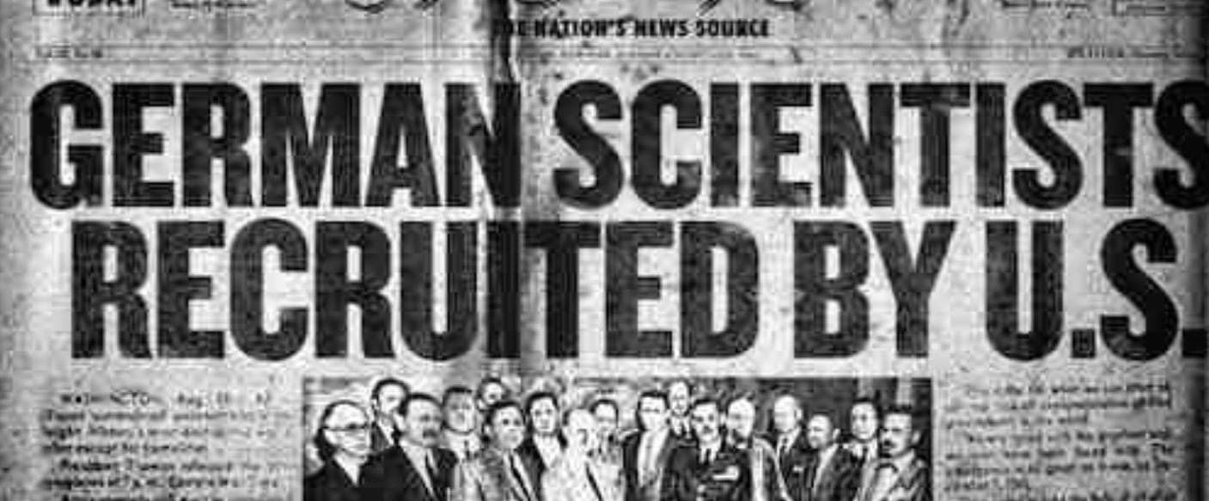
What are SIT Nanotech?
SIT/Nanotech – The most disturbing information!
SIT – means “Satanic Information Technology”. This technology was not invented by man, by himself. Both WPNPs and SIT began with Project Paperclip – Nazi doctors and scientist that were consulting with fallen angels and/or demons/Nephilim then brought to America and other nations.

Slide 10
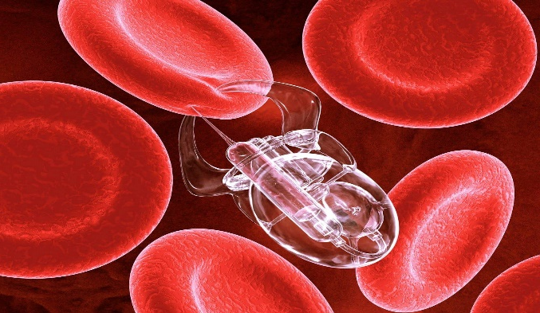
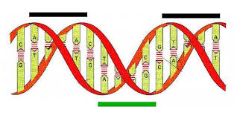
What are SIT Nanotech?
SIT – Nano size, such as Smart Dust created by DARPA. Universal exposure, most people have multiple types.
SIT – Complicated and not fully understood. Each category has its own specific functions. Overall, they provide a power supply, support, both defensive and offensive support to WPNPs and other SITs.
SIT – They help make the customized attack against the body.

Slide 11
SIT – 22 Types/Kinds & function
Power Supply Tech
1.1 Battery Tech
Stealth Tech
Virus Tech
Intelligence/process Tech
Repair Tech
Network Tech
Communication Tech
6.1 Barrier Tech
6.2 Grounding Tech
6.3 Corruption Tech
Doorway Tech
8.1 Gateway Tech
Counterfeit Tech
9.1 Machine Tech
Defensive Tech
10.1 Redirection Tech
Transportation Tech
Master Tech
Chaos Tech
Life Support Tech
Building Tech
Spyware Tech
Senses Tech
Locator & Tracker Tech
Gathering Tech
19.1 Splitting Tech
19.2 Lying Tech
19.3 Bondage Tech
Storage Tech
Offensive Tech
Legal Tech
22.1 Light Tech
23. Spirit Tech
24. Geopathic Tech
25. Pharmacy Tech
26. Spell Tech

Slide 12
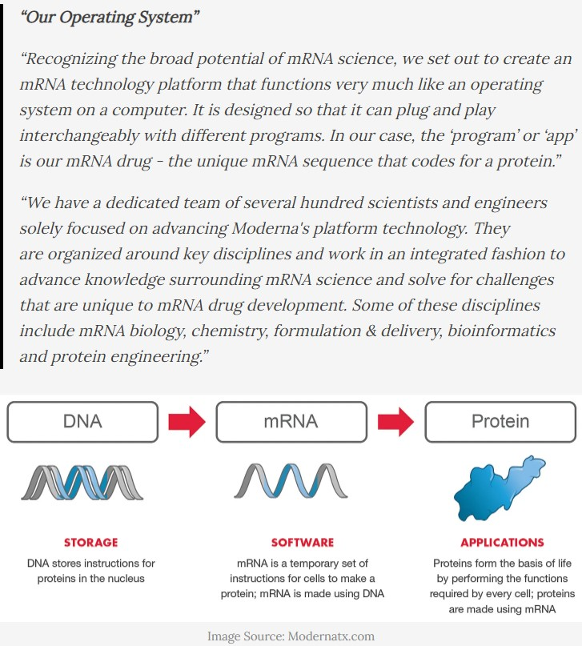
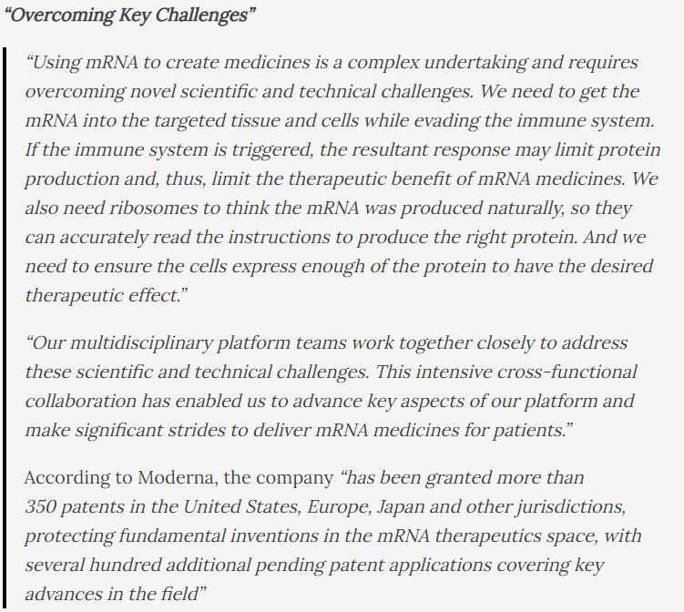

Slide 13
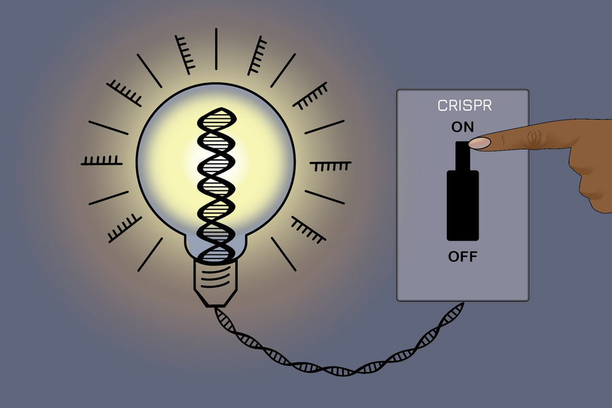
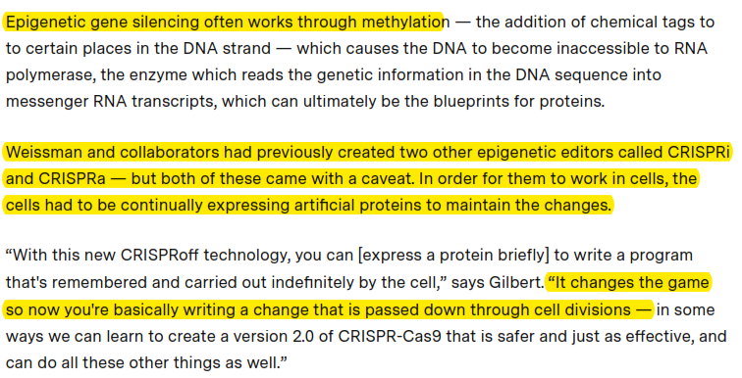
MIT News: An On-off switch for gene editing
https://news.mit.edu/2021/switch-crispr-gene-editing-0414

Slide 14
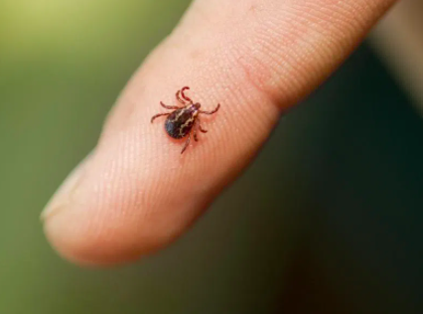
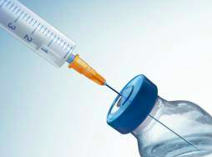
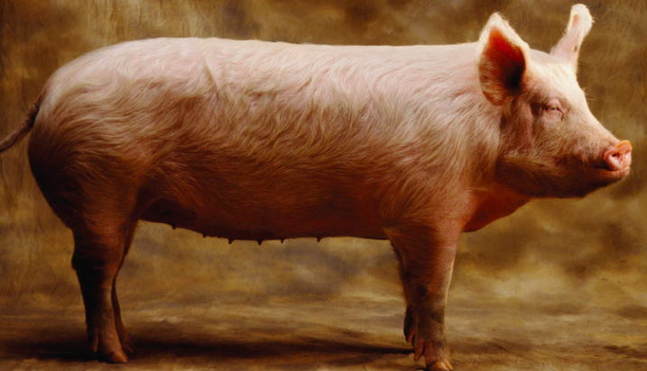
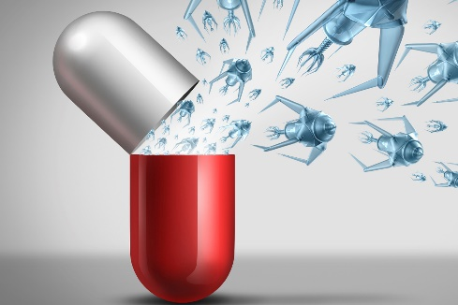
WPNPs Exposure – how does one get them?
WPNPs – There are four main vectors (sources of exposure):
Vaccines / Injections
Bites from Ticks, Spiders, and Mosquitos.
Aerosol Spraying
GMO Foods, Drugs and/or Unclean Animals
Another possible source of exposure:
Plasma / Wi-Fi / 5G Weapons
Spiritual attacks

Slide 15
Signs of WPNPs infections
WPNPs – Common symptoms / disease caused by just WMFI: (according to documents from “Medical Research Foundation” and “The Armed Forces Institute of Pathology”)
AIDS
ALS
Cancer
IBS – Crohn’s or Colitis
Diabetes
Chronic Fatigue /Myalgic encephalomyelitis
MS & Parkinson’s
RA – Rheumatoid arthritis
Alzheimer’s
Auto-immune – thyroid
Wegener’s disease
Collagen-vascular diseases
Lyme
Fibromyalgia
They also mention – Creutzfeldt & Jacob Diseases !!! (Prions)
Disease often depends on the strength of the WPNPs.
For example: WMFI at 10 to the 10th (1010) power will develop into AIDS!
(108) – Chronic Fatigue, Fibromyalgia
(107) – a wasting disease, not death, but not interested in life.
In other words ALL OF THE DISEASES we never use to get!!!!!

Slide 16
WPNP vs Biological Warfare & Other Man-made stuff
Weaponized Pathogen (WPNP) – not the same as others, these are genetically modified organisms with the intent to control, not to kill!
Biological warfare (BW)—also known as germ warfare—is the use of biological toxins or infectious agents such as bacteria, viruses, insects, and fungi with the intent to kill or incapacitate humans, animals or plants as an act of war.
Mutations - a mutation is an alteration in the nucleotide sequence of the genome of an organism, virus, or extrachromosomal DNA. They can be good or bad and can occur due to several events. Mutations may or may not produce discernible changes in the observable characteristics (phenotype) of an organism. Mutations play a part in both normal and abnormal biological processes

Slide 17
How do WPNPs function and/or Attack?
WPNPs – Other strange effects of WPNPs:
Many can bend light and make themselves invisible to the body’s immune system. They use other stealth methods to hide.
They can exist in the body for 10, 20, 30 + years dormant and then become activated by Trauma, any type of Trauma. (TAFIP) ***Hint
does that sound like vaccine damage – that cause auto-immune disease!!
3. They can most likely be activated by EMF, Plasma weapons and Spiritual
attacks.
4. They can shape-shift, due to the undifferentiated nano pathogens
mingled seed.
5. They can make custom attacks by scanning your body and finding your
weakest areas. They make fake Peptides!

Slide 19
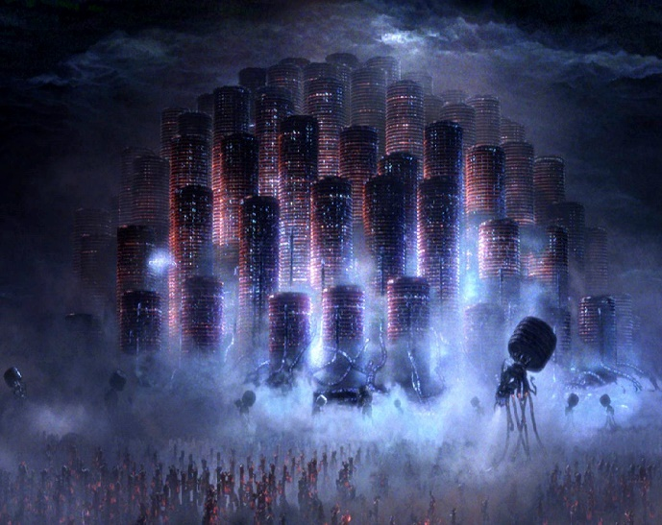
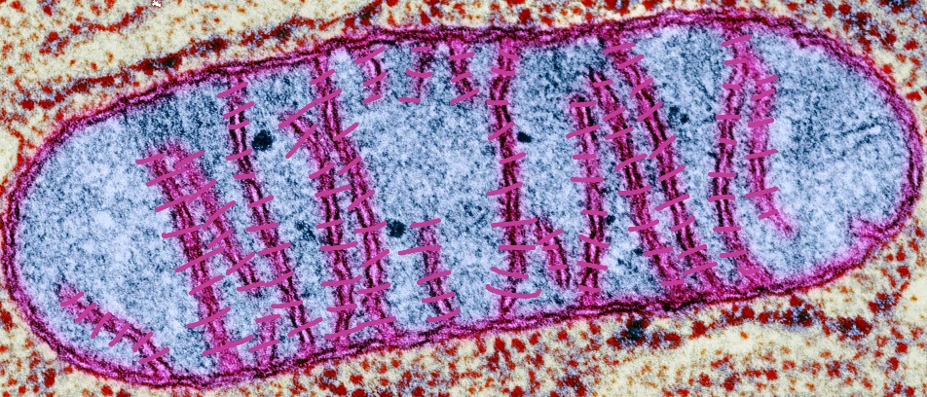
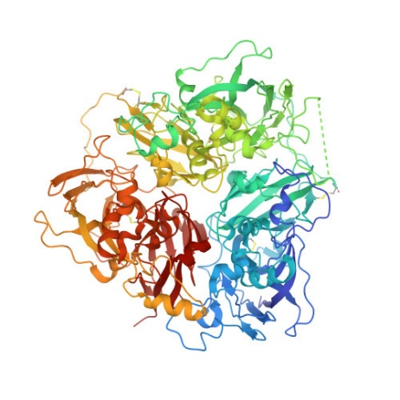
What is the Matrix?
Magnesium (Mg)
ATP
Mg-ATP
Retinol (A)
Iron (Fe)
Copper (Cu)
Ceruloplasmin (Cp)
ferroxidase enzyme

Slide 20
What is the Matrix?
Oxidative Stress
Inflammation
Mitochondrial dysfunction
Epigenetics thus Methylation Issues
Magnesium (Mg)
ATP
Mg-ATP
Unbound Iron
In Cell/tissue
Retinol (A)
Iron (Fe)
Copper (Cu)
Ceruloplasmin (Cp)
ferroxidase enzyme

Slide 21
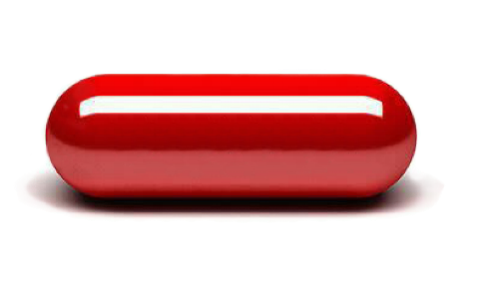
Virus Tech – Wait what is a virus???
Facts about Viruses :
They are not living
They are a small collection of genetic code surrounded by a protein coat
A virus cannot replicate alone
It must infect cells and use the cell to replicate
The 2020 Virus Debate!
Virus as a Pathogen – The smallest common pathogen.
Virus as an Exosome – Unhealthy cells release exosome.
The Truth – Red Pill about Viruses!!!!
A Virus is Bad Software!!!

Slide 22
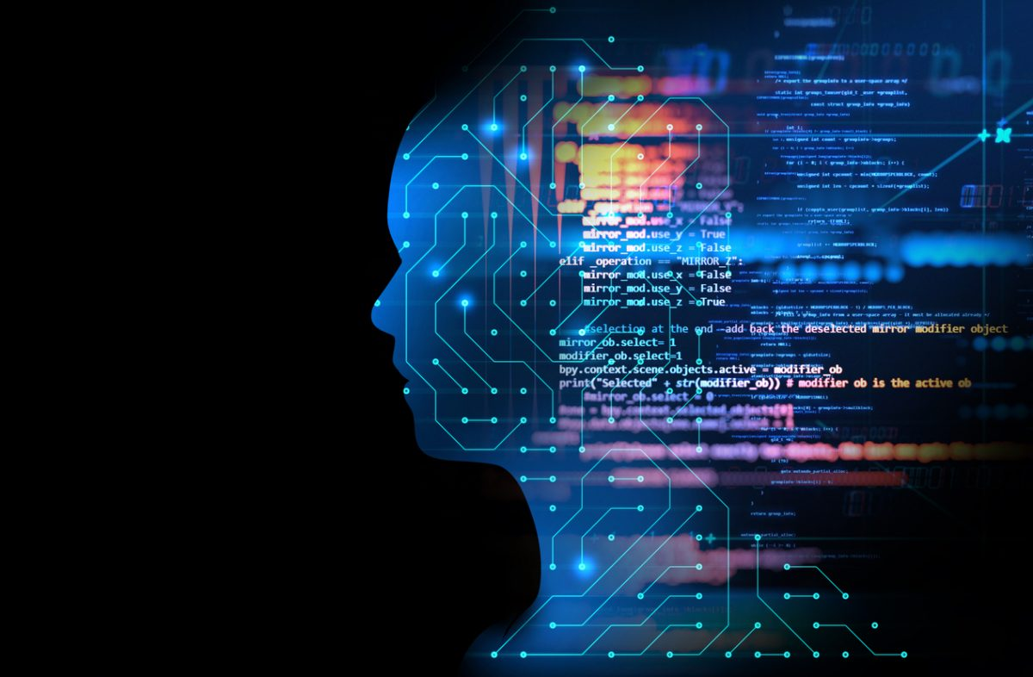
Virus is Bad Software
This means:
Unhealthy cells spit out viruses as the body’s software gets corrupted.
You can pick up a virus (material w/ software) from other people or environment
They can be made!!
They are Information not pathogens!!

Slide 23
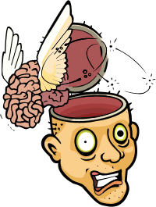
What About Covid & Current Events
Same in all 3 injections – Moderna, Pfizer, Janssen
CRISPRi
CRISPRa
Synthetic - Artificial mRNA
MRC-5 human diploid cells
Host cell DNA (Human)
Polysorbate 80
Hydrogel or Hydrogel Biosensors
WPNPs: WHRV, WSB, WBB, WCSV, WNCP, WUNP, WMSB
Nanotech – SIT #1, 2, 3, 7, 12, 13, 15, 20
Graphene Oxide or Magnetite Graphene Oxide or Reduced Graphene Oxide
Cholesterol
Yeast Protein
LIPID ALC-0315, ALC-0159, 1,2-Dist..
Polyethylene Glycol
Many Heavy Metals & Toxins

Slide 24
What About Covid & Current Events
Differences among the 3 injections – Moderna, Pfizer, Janssen
WPNPs: Moderna has 20 additional, Janssen has 9 additional, Pfizer has 9 additional
Nanotech – SIT Moderna has 5 additional, Janssen has 3 additional, Pfizer has 3 additional
Many Heavy Metals & Toxins: Moderna has 20 additional, Janssen has 9 additional, Pfizer has 17 additional
Emotions – Frequency based
Pfizer has adenovirus w/ mRNA inside

Slide 25
What About Covid & Current Events
Damage due from the injections
Attacks the Aleph-Tav Hebrew Letter command centers
Changes 80+ genes via the Chromosomes
Huge toxic load of chemicals
Many weaponized pathogens
Many types of Nanotechnology
Causing the body to make 5 different categories of fake proteins
Changes the magnetic polarity plus the rate & spin of atoms
Affects the Copper/Iron Metabolism – Energy, Inflammation, immune, etc.
Affects the mental, emotional, and spiritual levels
Systems under attack: Reproductive, Cardiovascular, Immune,
Respiratory, CNS, Endocrine, Liver, Digestion
Turn off Methylation genes
Creates autoimmune issues
Designed to spread to others
Mark of the Beast - ?? Possibly the first layer

Slide 26
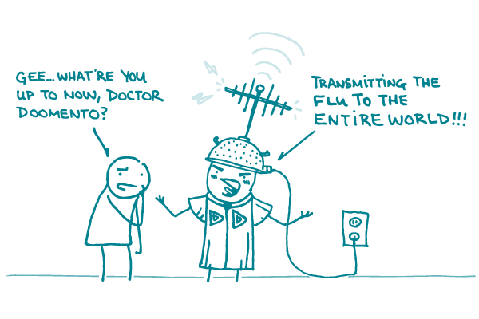
What About Covid & Current Events
Spreading from the injections
Shedding – WPNPs
Transmitting – Proteins, Nano, Pheromones
Quantum Resonating – Energy Commands Centers
Quantum Entanglement & QE Soul tie – Wi-Fi Connection
Out gassing - toxins, venom (peptides), etc.

Slide 27
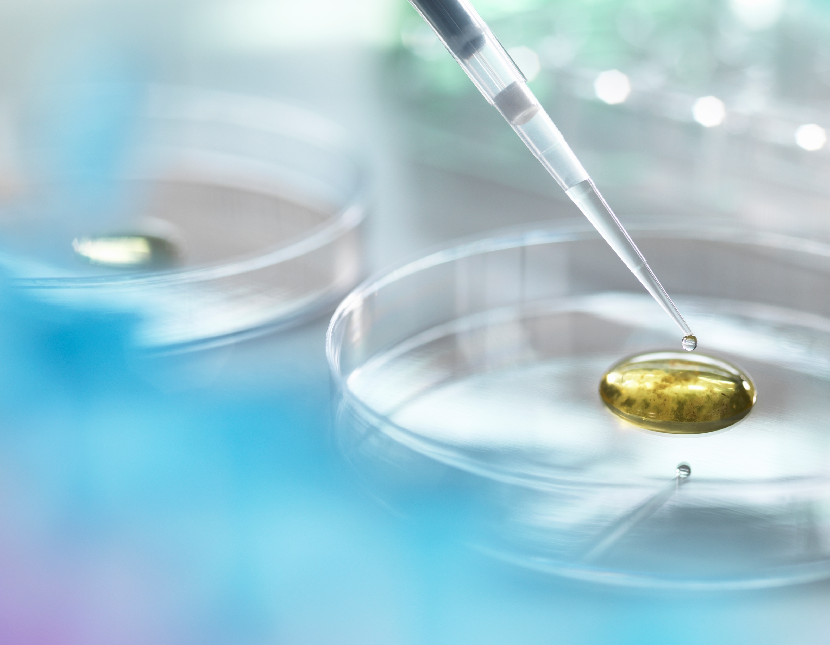
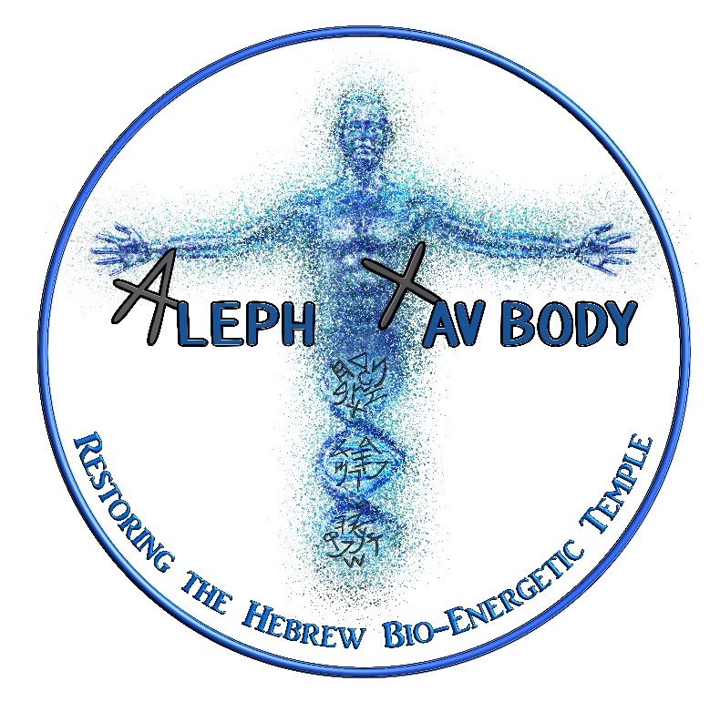
coherent restore
Dr. Alphonzo Monzo, ND

Slide 28
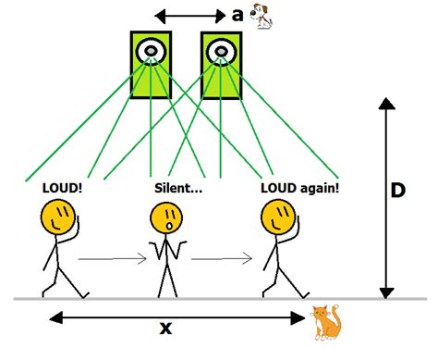
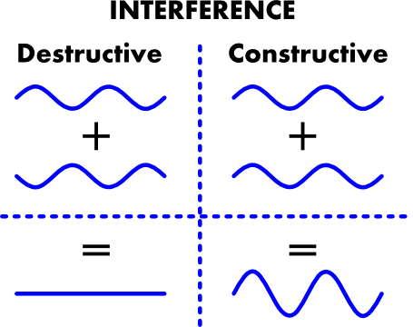
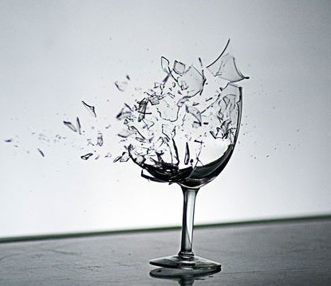
Louder, Stronger, enhanced

Slide 29
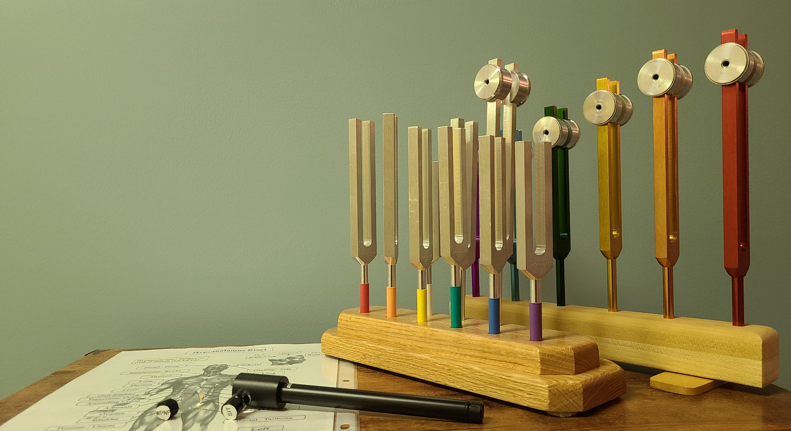
ATB Coherent Restore Hope for mankind!!
Aleph-Tav Body Coherent Restore is a method I invented to take out Weaponized Pathogens and SIT nanotech.
ATB Coherent Restore uses: 1) Touch 2) Light Frequency 3) Sound Frequency 4) Prayer & Body Commands.
It uses the “laying on of hands” onto Hebrew Command points found in the Aleph-Tav Body System, Laser with specially formulated frequency vials, tuning forks, and prayer/commands.
It uses 4 different informational vials and can be done in person or via DNA surrogate connection.
ATB Coherent Restore uses a surprise attack to:
Turn on certain genes
Remove SIT Nanotech
Eliminate WPNPs
Restore the Hypothalamus & Neuro-Endocrine System
Realign energetic misalignments
Restore Nerves, Cells, DNA, and organ function.

Slide 30
What you can Do to protect yourself!!
TO DO:
Cod Liver Oil
Beef Liver or Beef Organs (Grassfed)
Trace Minerals
Magnesium
IP6 Gold
Wholefood C
Copper (Sulfate or gluconate) – start slow 2mg & work up
Fulvic & Humic Acid (Plant-soil based!! Not rock)
Ionic Boron (3-6mg)
EMF & RF Protection w/ 5G protection (Aires Tech, EMFSol, etc.)
CVA & ATB Coherent Restores
Strong Magnetic Fields NOT electromagnetic fields!!!!
(Remember EMFs/RFs cause
Nanotech to self-replicate and self-
organize, thus build networks and
Technology in the body!!!)
TO STOP:
Get off all synthetic Supplements – Follow the RCP Stops www.therootcauseprotocol.com
NO Vitamin D Replace w/ Cod Liver Oil
NO Ascorbic Acid Replace w/ Wholefood C
NO High Dosage Zinc Replace w/ Copper

Slide 31
https://drmonzo.kartra.com/page/vbm1
www.well-beingbydesign.com
All of our contact info is at the website.
If you need help contact us!
If you would like to learn more or get trained contact us!
Dr. Alphonzo Monzo, ND

